Slide 1
Organization behaviour & culture
By Miss Noreen

Slide 2
About MEMBERS
NOOR BAHO
Freelancer
Skills: Web Development, Graphic Designing,
ADNAN SHAHID

Slide 3
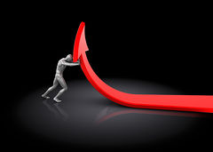
GOOD TO GREATBY JIM COLLINS

Slide 4
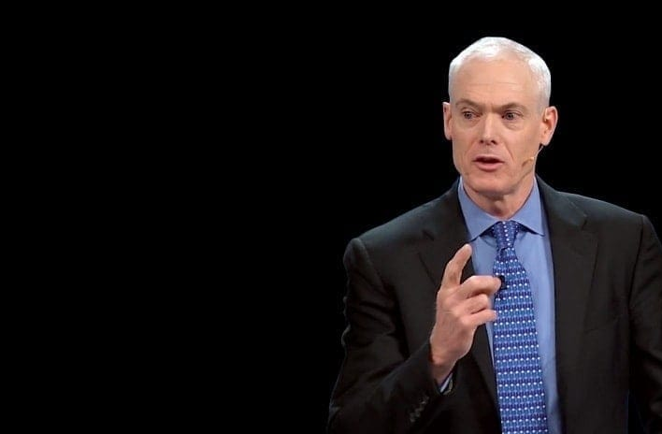
JAMES COLLINS(1958-Present) (JIM COLLINS)
Publications:
Built To Last (1994)
Beyond Entrepreneurship (1995)
Good To Great (2001)
Good To Great And The Social Sectors (2005)
How The Mighty Fall (2009)
Great By Choice (2011)

Slide 5
REASONS ”Good to Great”
Challenged by Collins’ friend Bill Meehan
Curiosity

Slide 6
“Good is the enemy of great”
Jim Collin

Slide 7
“Just Being Good”
Great Companies have always been great,
Good companies remain just that good.
Because of disease

Slide 8
Inside The BLACK BOX
Great Results
BLACK
BOX
Good Results

Slide 9
Level 5 Leadership
BREAKTHROUGH!
Build Up . . . . .
Level 5
Leadership
First Who…
Then What
Confront The
Brutal Facts
Hedgehog
Concept
Culture Of
Decipline
Technology
Accelators
DISCIPLINED PEOPLE
DISCIPLINED
THOUGHT
DISCIPLINED
ACTION
FLY WHEEL

Slide 10
First Who… Then What

Slide 11
Confront The Brutal Facts (Yet Never Loose Faith)

Slide 12
The Hedgehog Concept (Simplicity within the three circles)

Slide 13
A Culture of Discipline

Slide 14
Technology Accelerators

Slide 15
The Flywheel & The Doom Loop

Slide 16
From Good to Great to Built to Last

